Slide 1
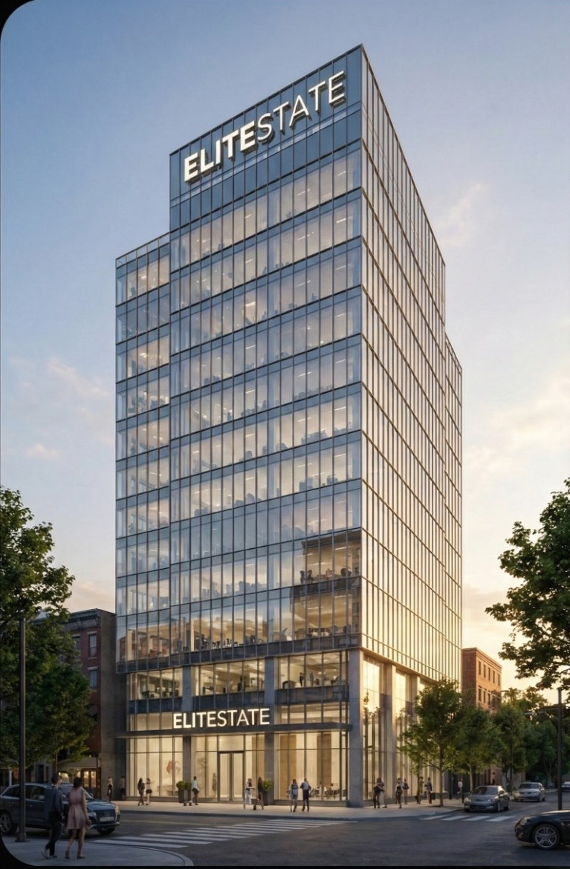

Elite States
The Legacy of Excellence
Malik Aliyan Zawar
Muhammad Hamza Qamar
Saad Mahmood
Muhammad Abdullah Siddique
Muhammad Sheharyar
Abdul Hannan.
Course: AICT-LAB | Instructor: Miss Ramsha Khalid | Date: 02-01-2026

Slide 2

Project Vision
Responsive, High-Fidelity Platform
Core Functionality
Facilitating property acquisition, rental services, and offering expert "Smart Investment" consultations to discerning clients.
To develop a sophisticated and adaptable luxury real estate platform, ensuring seamless performance across all devices.
Defining The Art Of Living
Our unique selling proposition lies in curating exceptional digital experiences that truly embody the art of luxurious living.

Slide 3
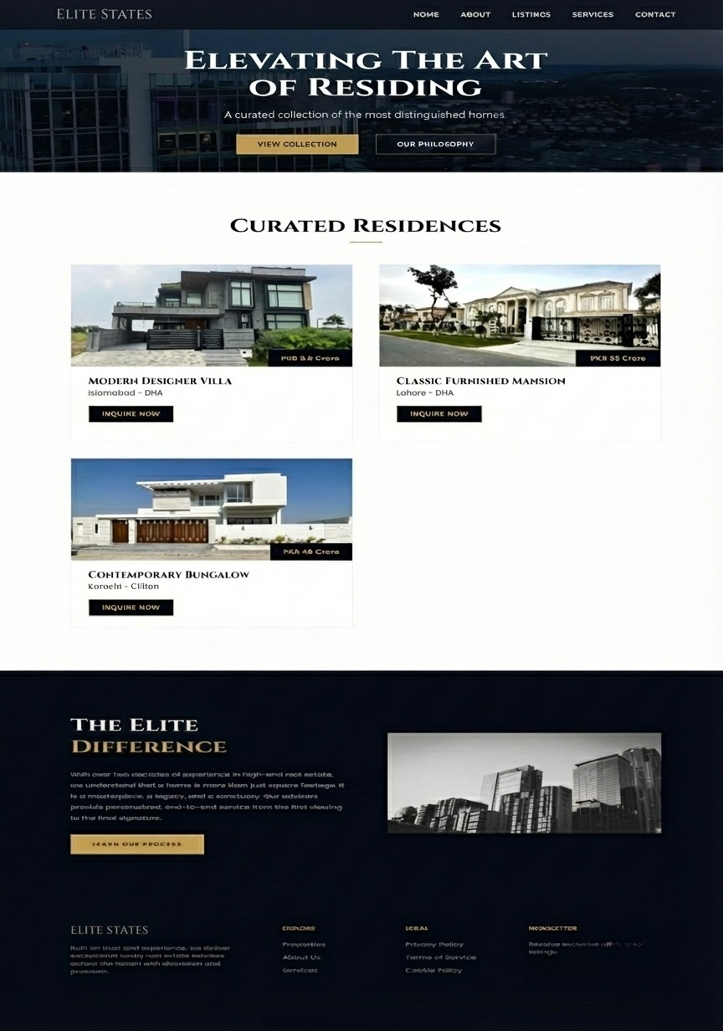
The User Experience: Home
Immersive Video Background
Sticky Navigation Bar
Ensuring effortless access to key sections with a discreet, yet functional, hamburger menu.
Engaging users with dynamic visual storytelling from the moment they arrive.
Responsive Hero Section
Delivering a visually stunning and adaptable first impression, optimised for any screen size.

Slide 4
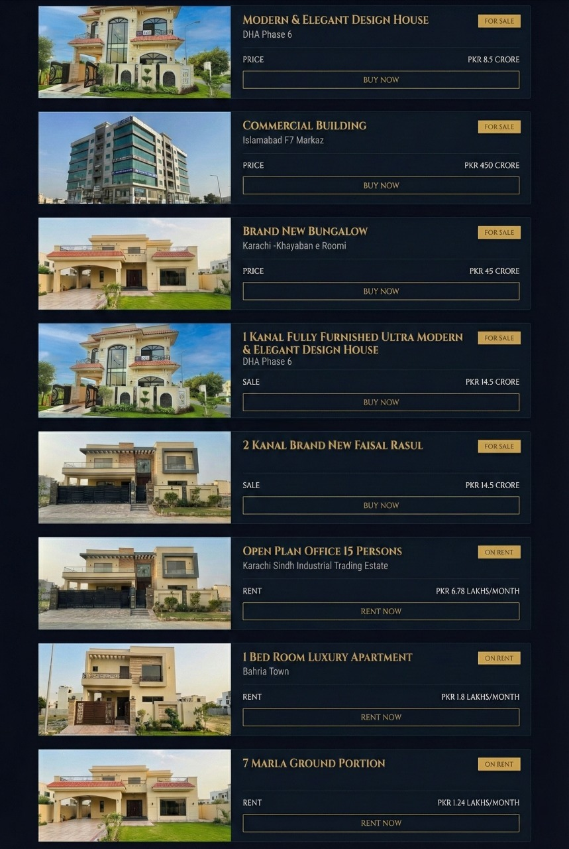
Curated Portfolio
Dynamic Filtering
Seamlessly toggle between properties available for sale and those for rent.
Distinct Card Styling
Elegant gold highlights for properties for sale, contrasted with sophisticated grey for rentals.
Grid Layout Implementation
Presenting a visually appealing and organised display of our exclusive property listings.

Slide 5
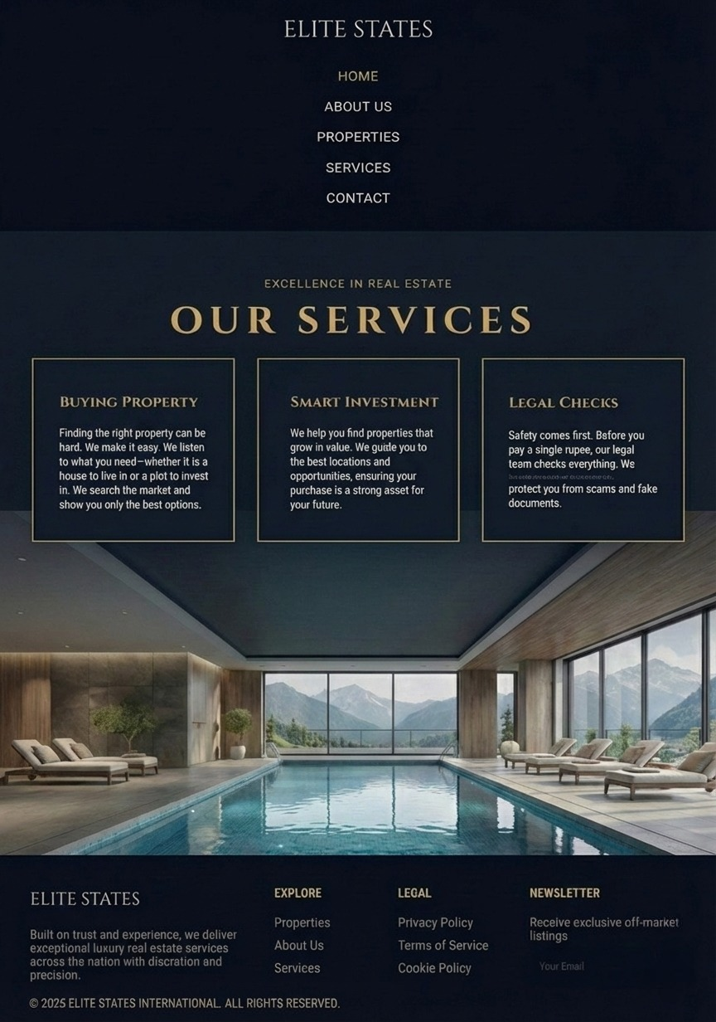
Strategic Services & Inquiry
1
2
1
1
2
Smart Investment Advisory
Secure Legal Checks
Expert guidance for informed decision-making in high-value property investments.
Ensuring peace of mind with thorough and validated property documentation.
3
3
Validation-Protected Forms
Streamlined and secure communication channels for all client inquiries.

Slide 6


A
Aesthetic & UI Strategy
Typography
Cinzel for titles, conveying elegance, and Inter for body text, ensuring optimal readability.
Color Palette
Black for authority, gold for wealth, and white for clarity, creating a sophisticated visual identity.
Tech Stack
Built with Semantic HTML5, CSS3 Variables, and robust Flexbox & Grid layouts for a modern foundation.

Slide 7
Future
Critical Reflection
Challenges Faced
1
Mastering complex responsive media queries for flawless mobile device compatibility.
Key Succes
Challenges
Key Successes
2
Successfully establishing a consistent and opulent 'Luxury' brand identity across all web pages.
Future Scope
3
Implementing robust backend integration for real-time property listings and dynamic content updates.

Slide 8
Property Valuation Data
Our platform specifically targets the Ultra-High-Net-Worth Individual (UHNWI) segment, offering unparalleled properties that reflect significant investment value.

Slide 9

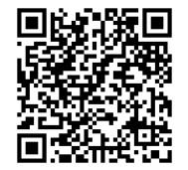
Live Implementation
GitHub Repository
Live Site
https://github.com/AICT-LAB-PROJECT/AICT-Final-Project.git
https://aict-lab-project.github.io/AICT-Final-Project/
Explore our project in action by visiting the live site or accessing the comprehensive code base on GitHub.

Slide 10


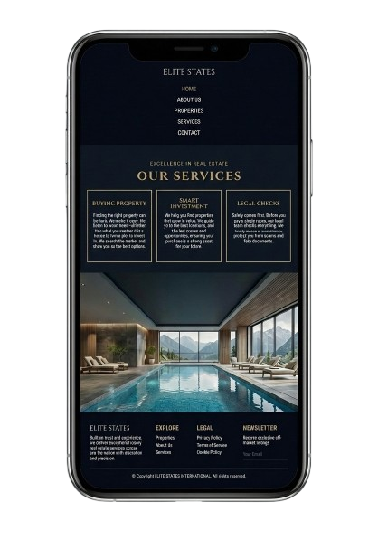
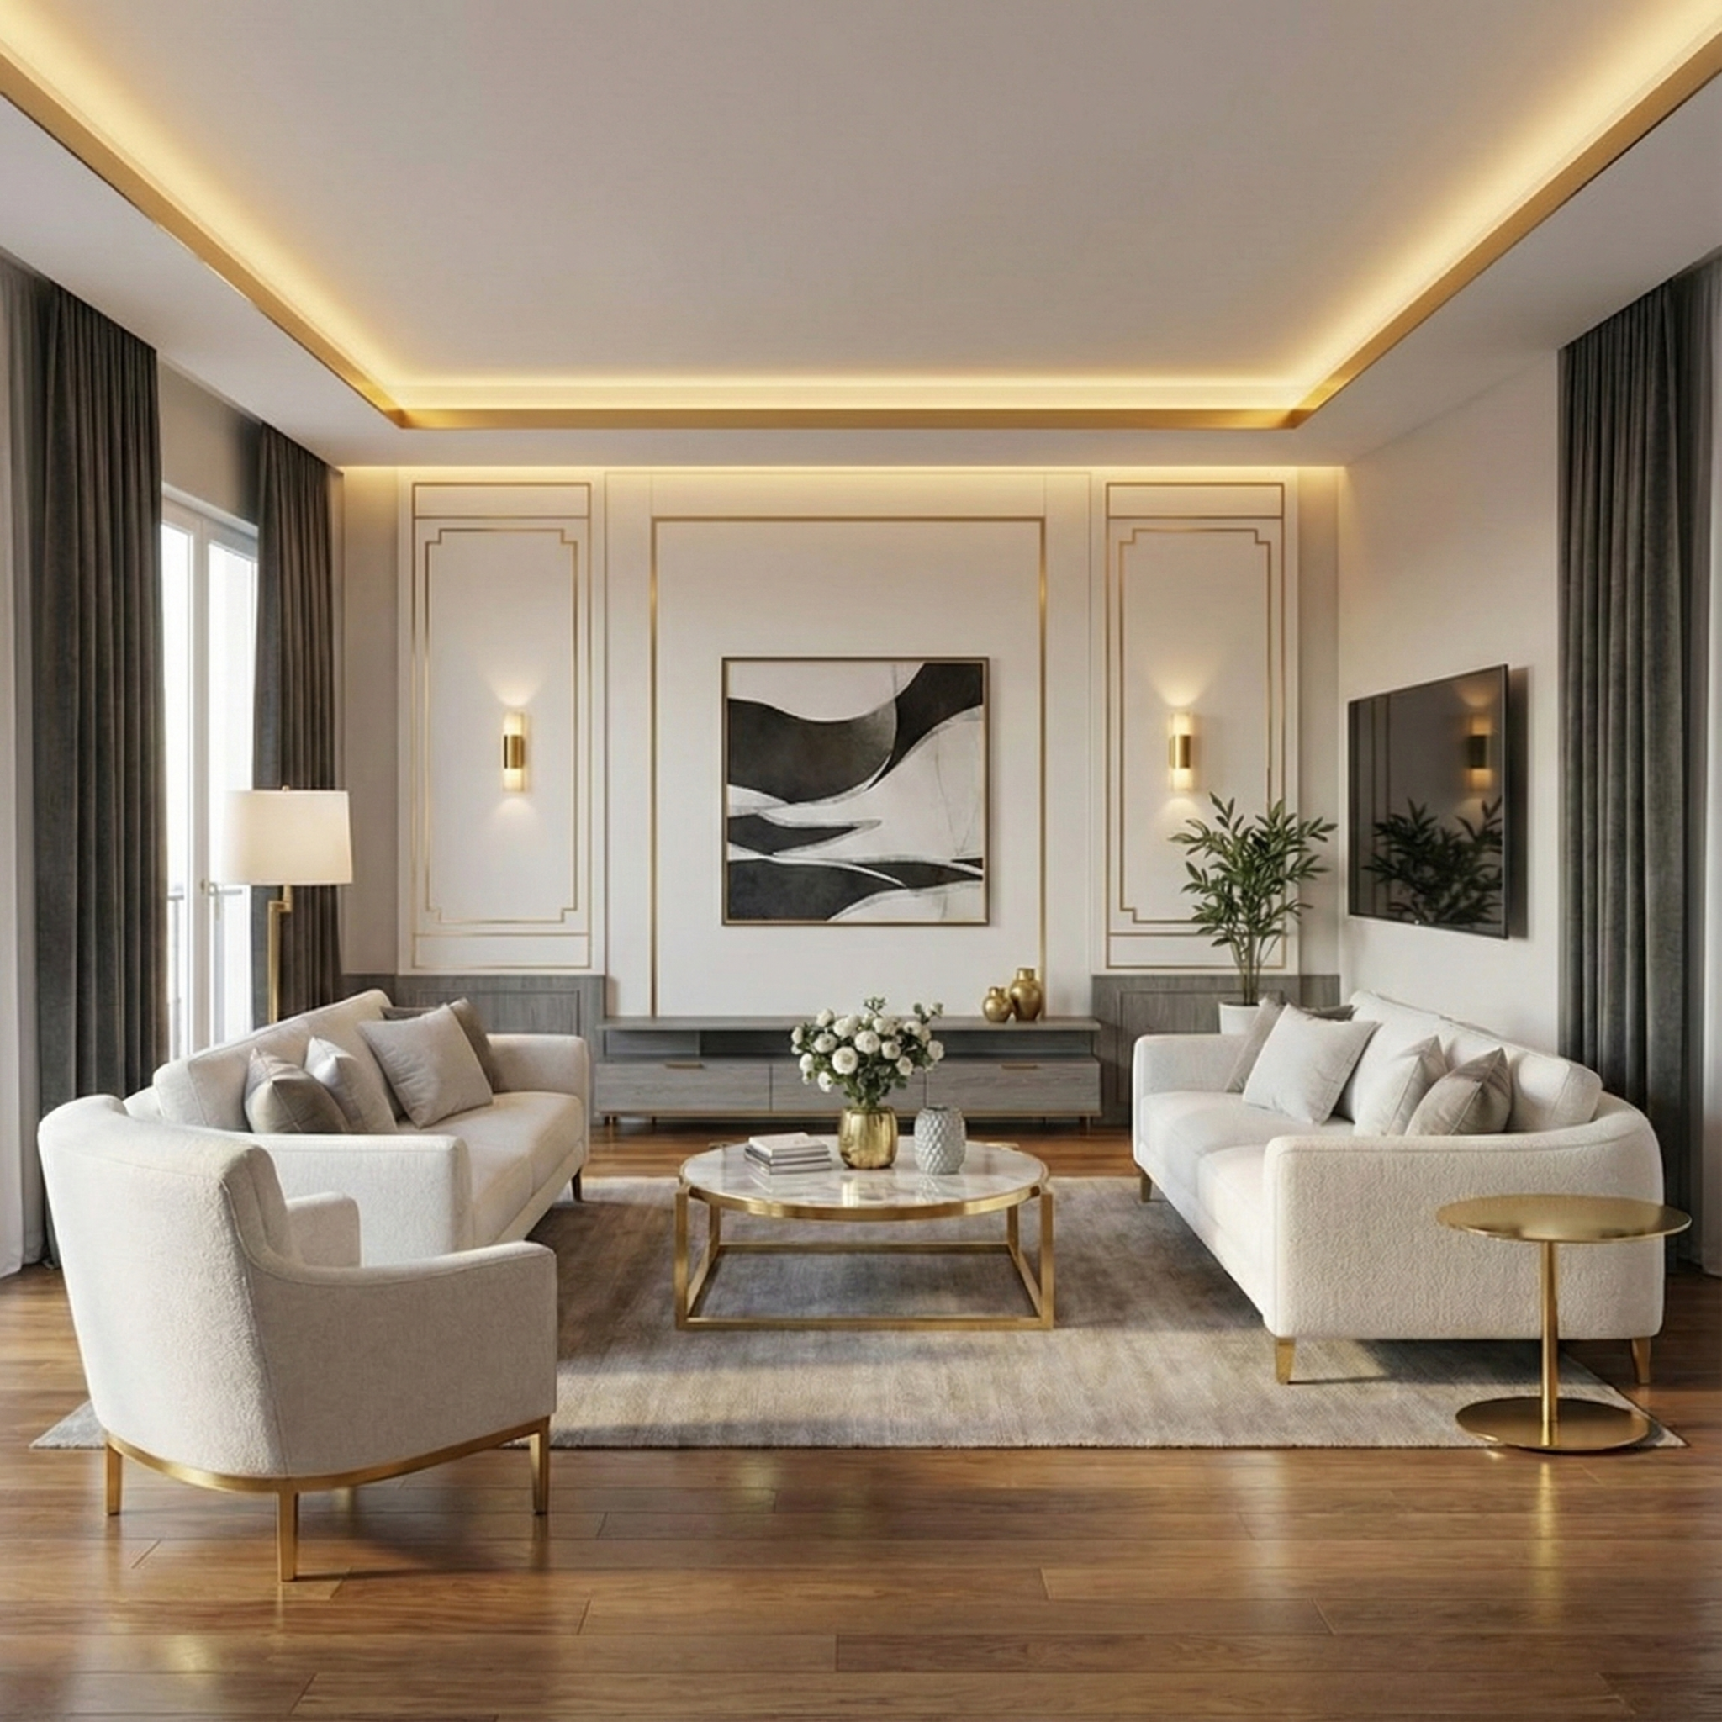
Critical Reflection: Our Journey to Excellence
Brand Identity Achieved
Responsive Mastery
Successfully establishing a consistent and excellent 'Luxury' brand identity across all web pages..
Learning how to use responsive media queries properly so that websites work perfectly on mobile phones and provide a smooth user experience on all devices.

Slide 11


Thank You
Elite State

